Slide 1


SRS Presentation
Adham Mohamed
Mark Ghattas
Abonoub Kaiser
Oussama Jablaoui

Slide 2



Team Members – Oussama Jablaoui

Slide 3


Slide 4
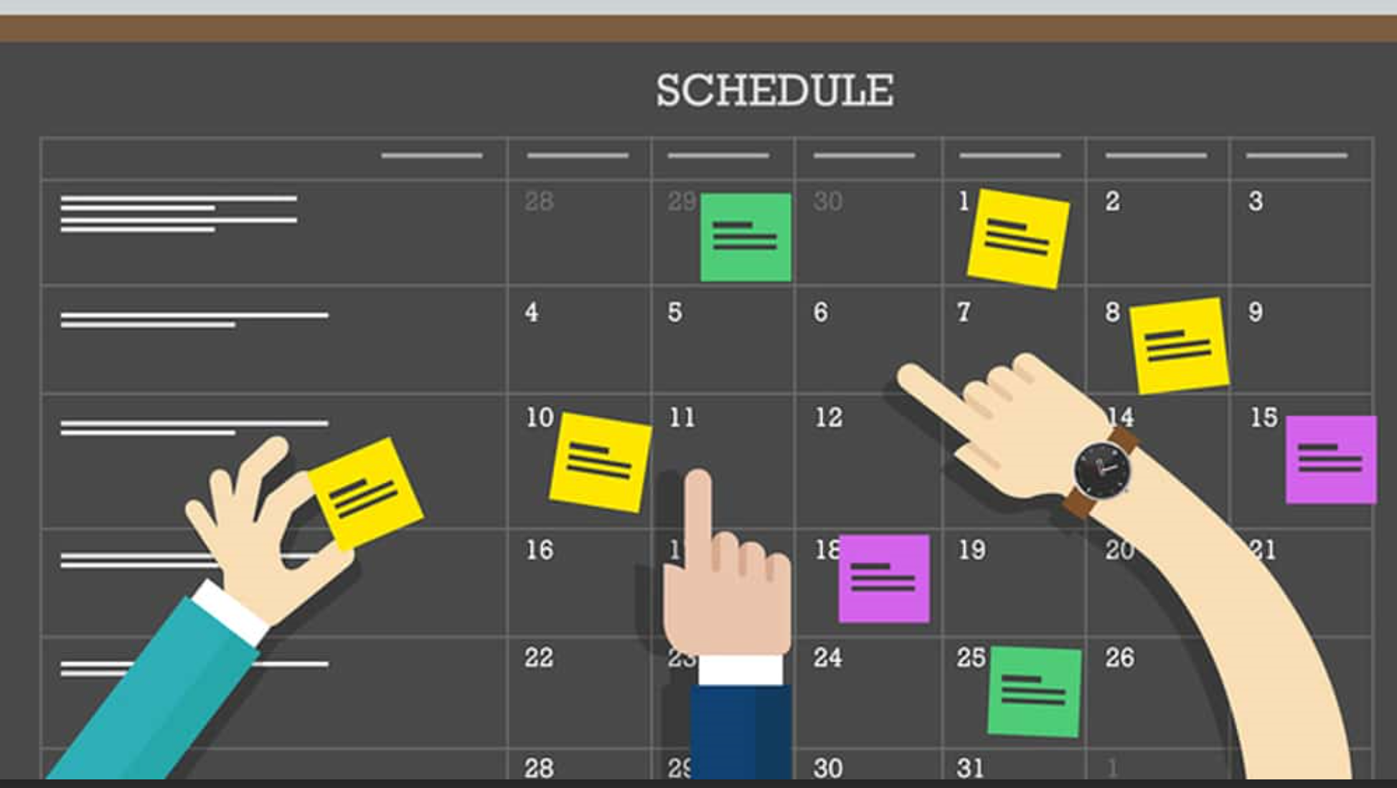

MIU Scheduler Introduction
Scheduling of the students for each entry was a redundant manual process using excel spreadsheet
This problem was addressed by initiating an automated scheduler tool that generated the schedule for a student and the professor based on their preferences and other factors.

Slide 5
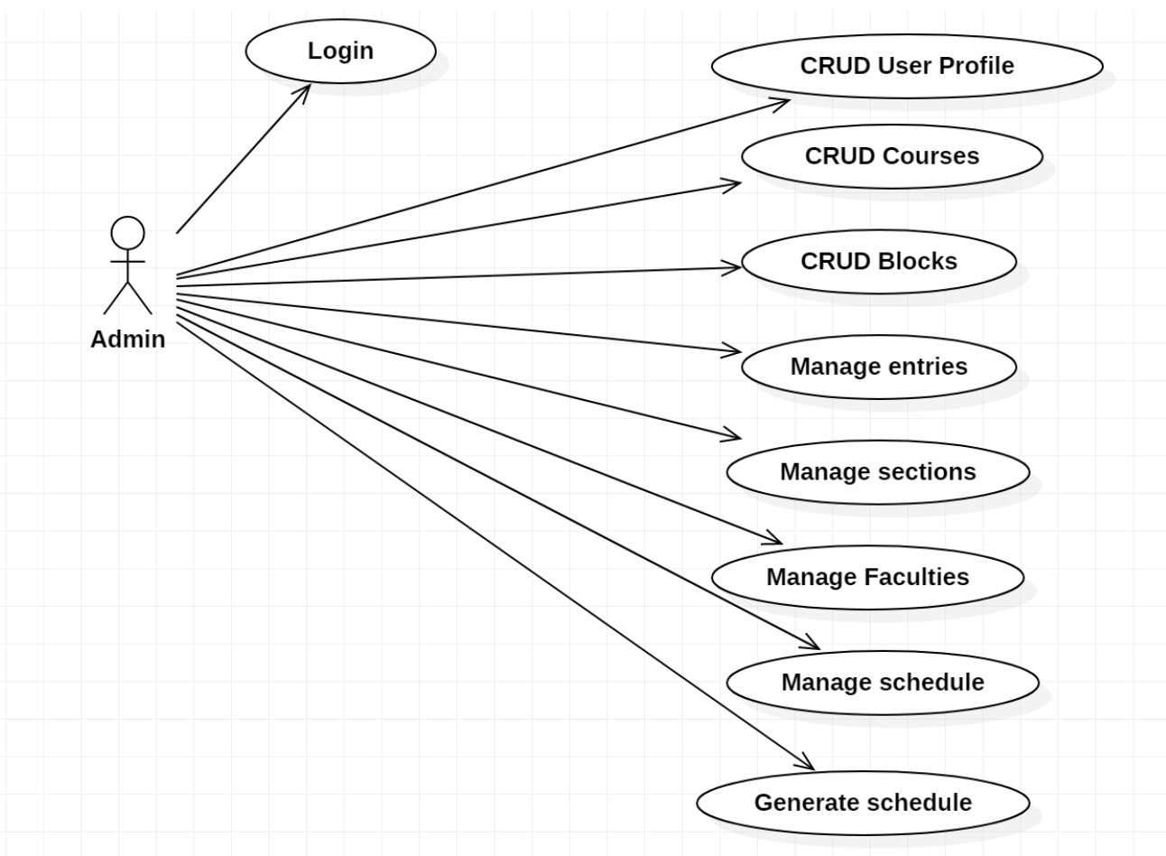
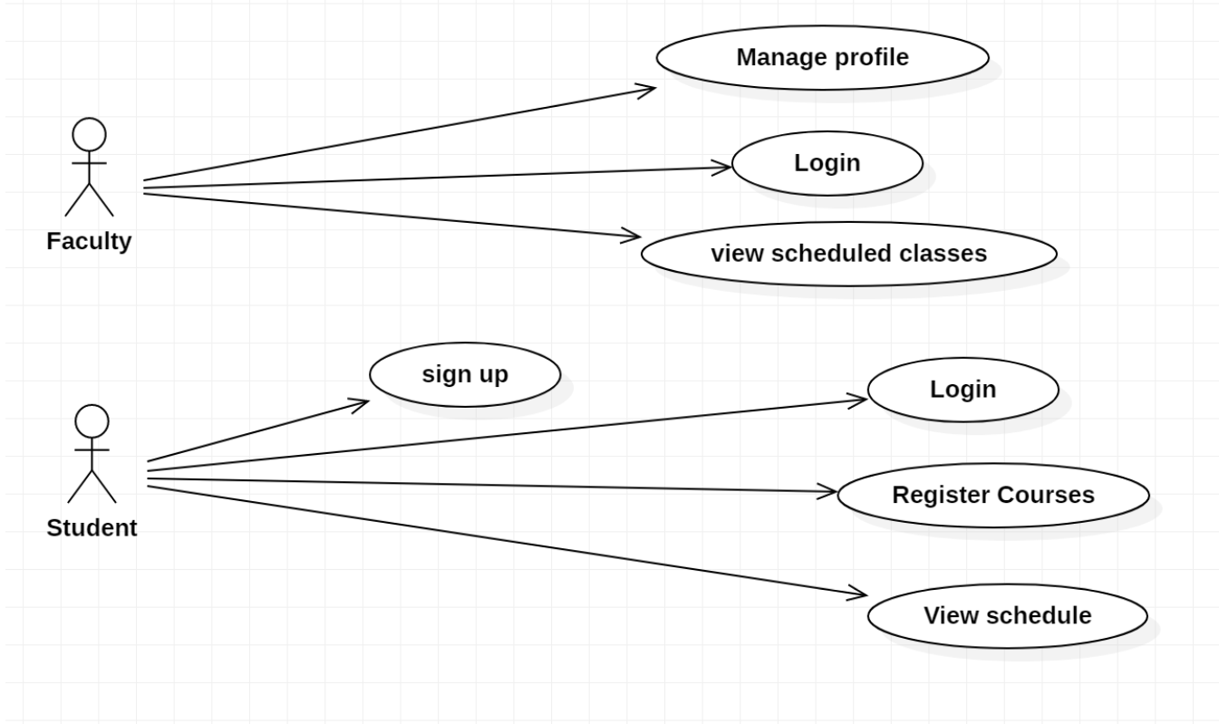
Use Case Diagrams

Slide 6
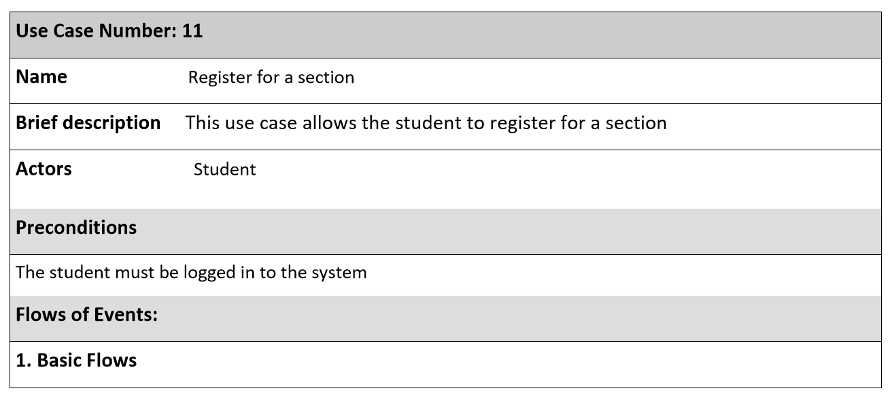
Use Case Description

Slide 7
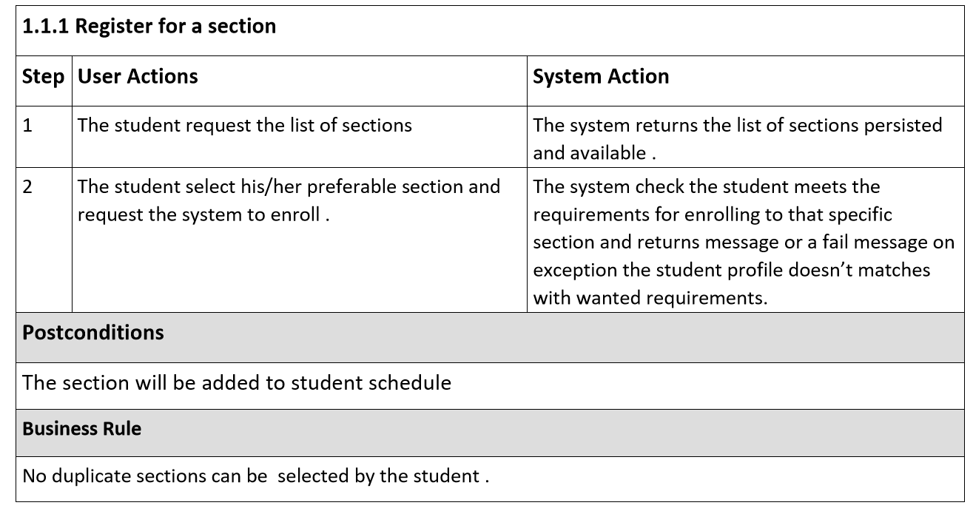
Use Case Description

Slide 8
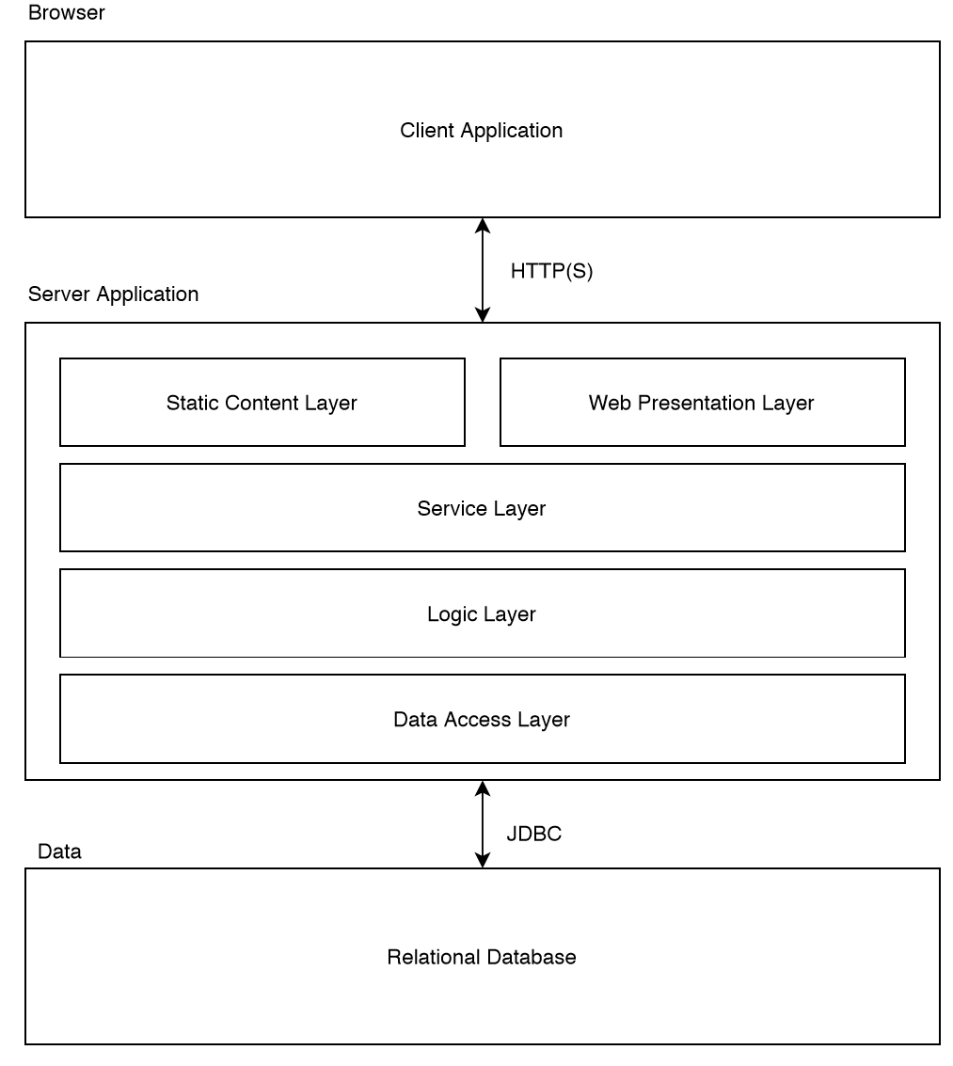



System Architecture

Slide 9
Key Abstractions
Student
Course
Block
Faculty
Section
Transcript

Slide 10
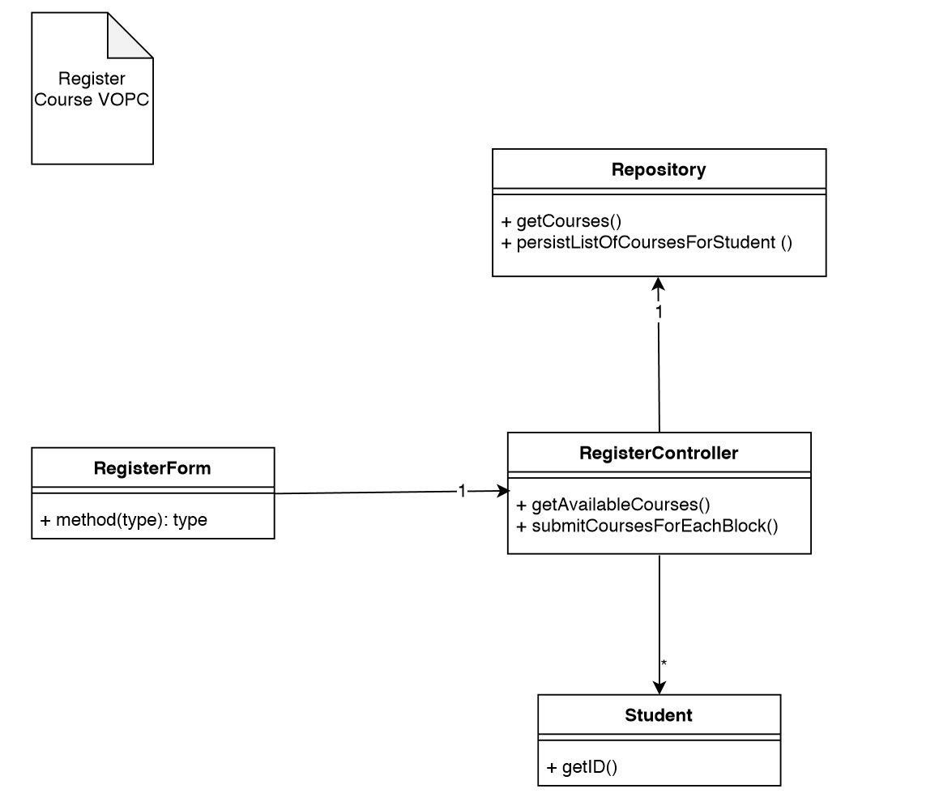
VOPC Diagram Register Course

Slide 11
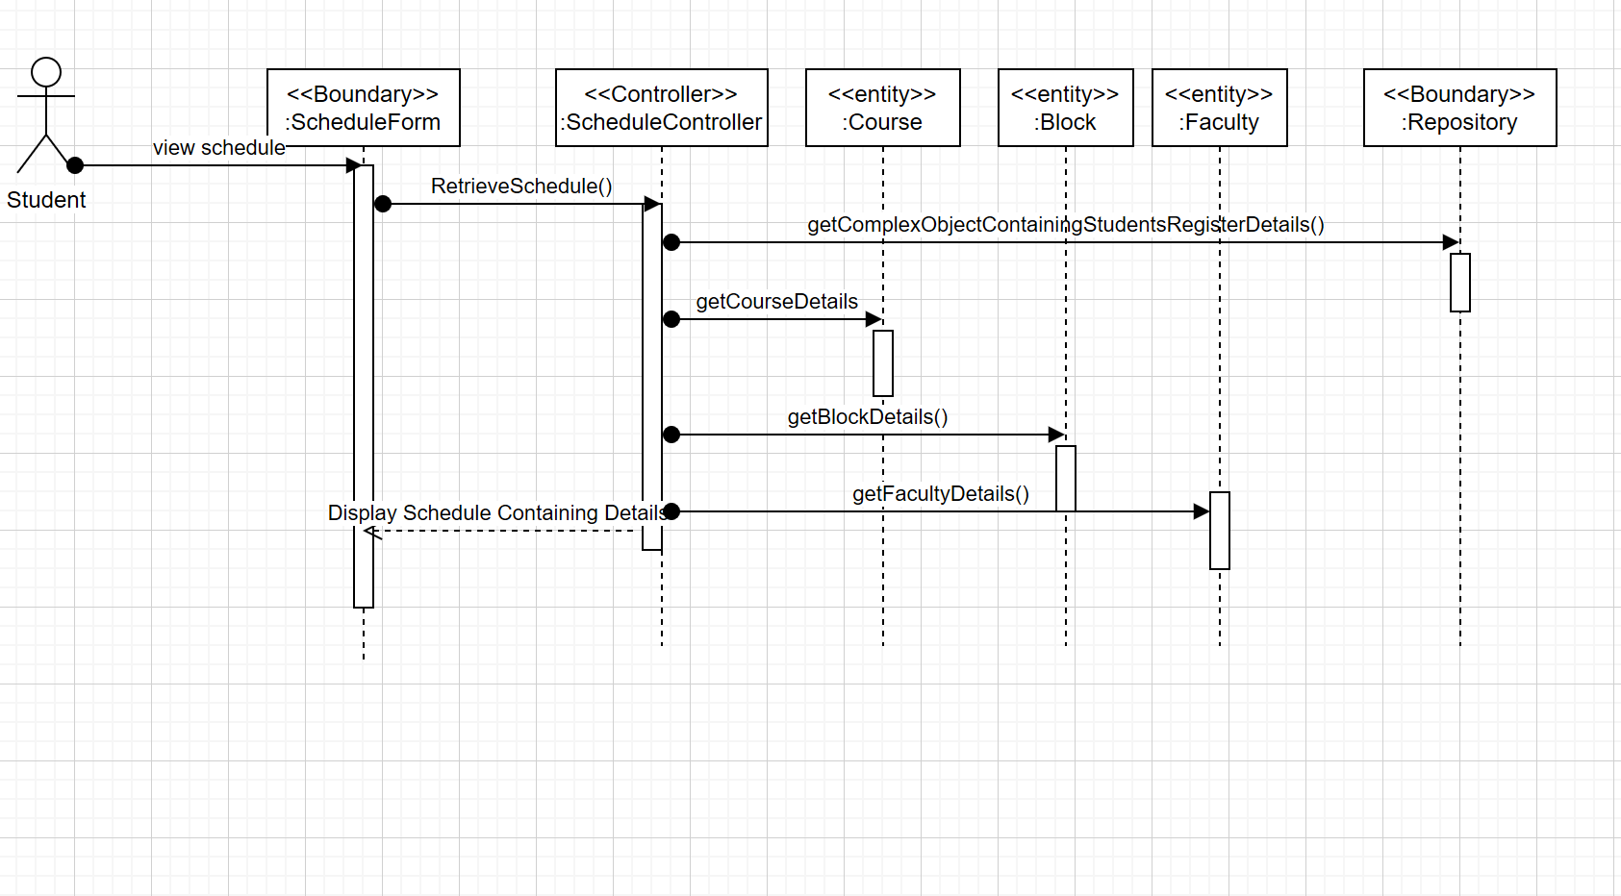
Sequence Diagram

Slide 12
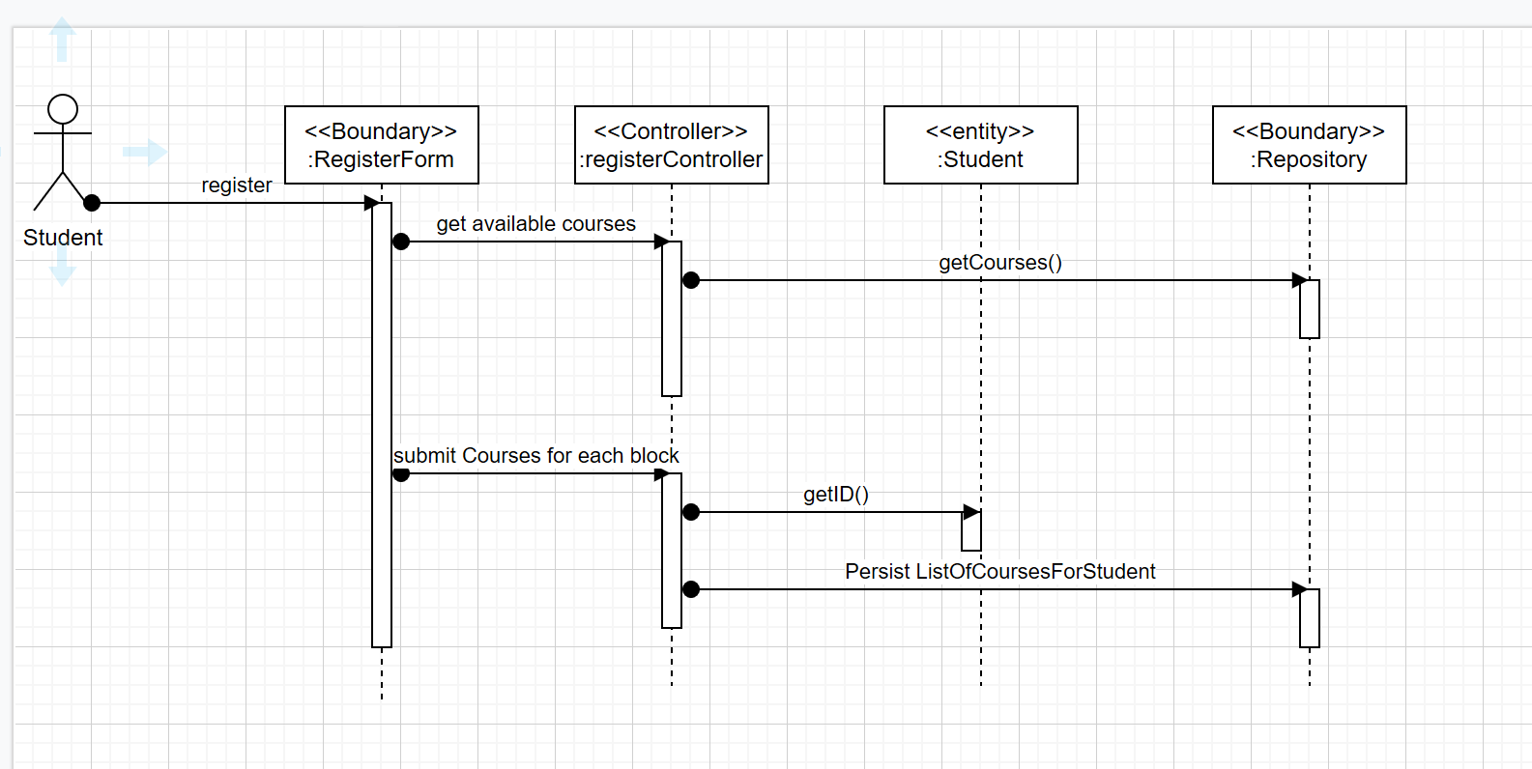
Sequence Diagram

